Slide 1
Improving All-Sky Searches for Long Transients
Avi Vajpeyi
The College of Wooster
Advisors:
Pia Astone
Andrew Miller

Slide 2

Sapienza
University of Rome
Notes:
Ill be working on this at the … with andrew and Dr. P Astone

Slide 3
Creation of Filters
Notes:
The main work I will be doing is with the creation of filters

Slide 4
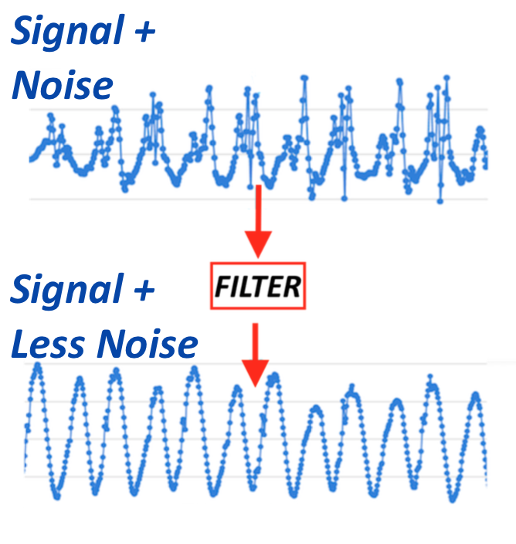
Filters
Help improve the distinction of signals from noise.
Notes:
A filter is just something that helps distinguish signals from noise.
Say you have some data that looks like this, such that the data contains a signal and some noise.

Slide 5
Filters
Help improve the distinction of signals from noise.
Notes:
When you pass the data through a filter, hopefully some of the noise will be reduced.

Slide 6
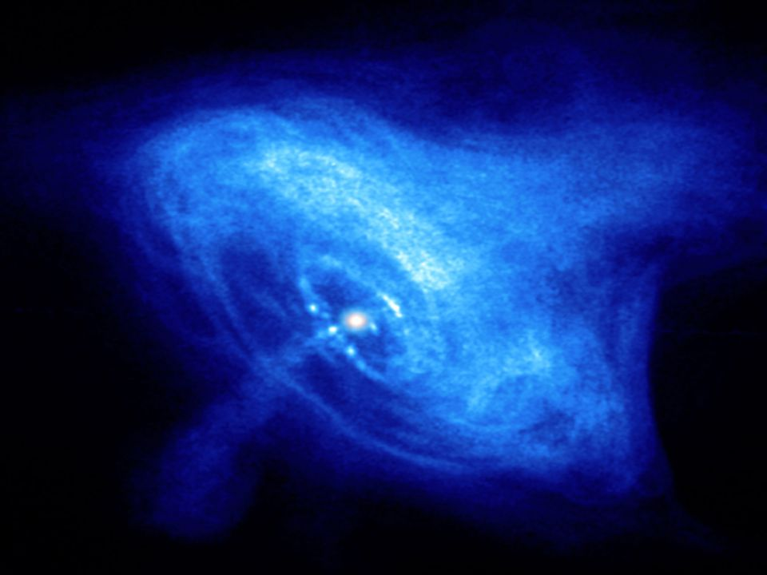
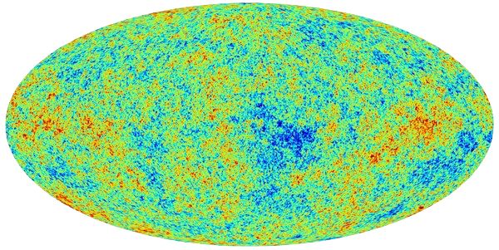
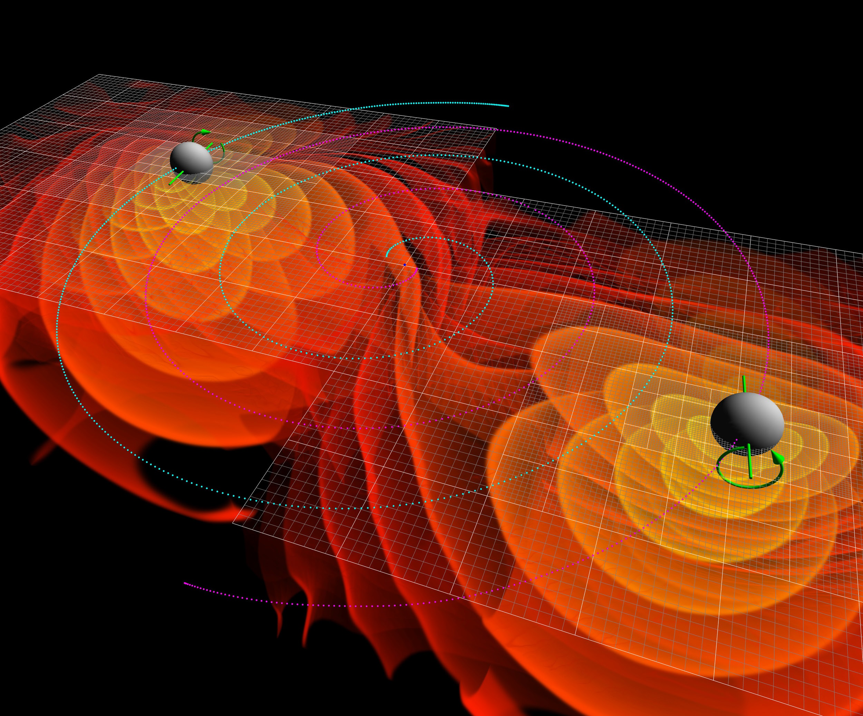
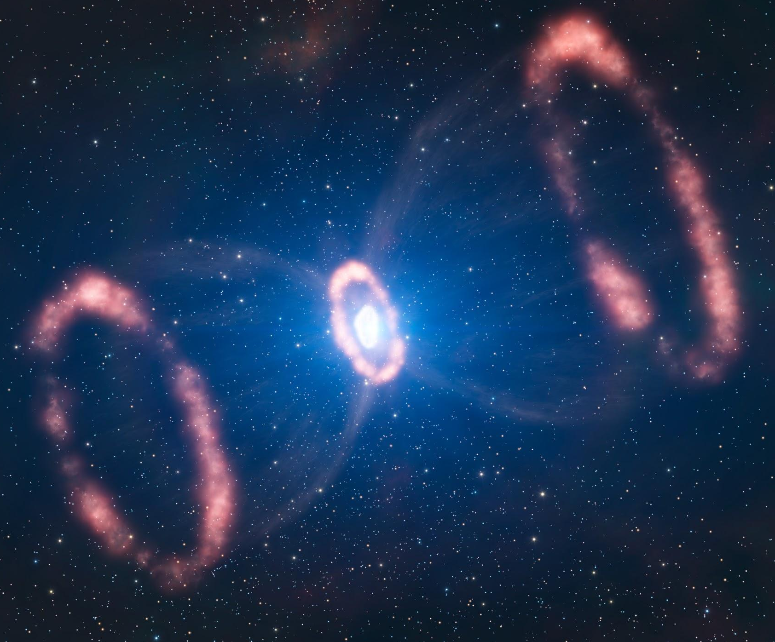
Filters are Used in Searches for GW
Continuous Waves
Stochastic Background
Compact Binary Inspiral
Burst
Notes:
Filters are already being used to help improve the SNR in data

Slide 7
Filters are Used in Searches for GW
Continuous Waves
Stochastic Background
Compact Binary Inspiral
Burst
Notes:
Ill be working with searches for Neutron stars.
The searches with NS were mostly done using (NEXT SLIDE) CGW

Slide 8
Continuous Gravitational Waves

Slide 9
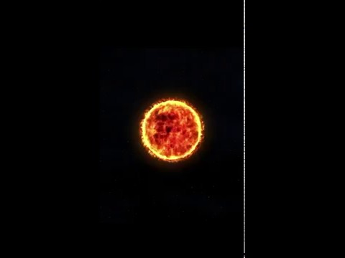
Neutron Stars
Neutron Stars are comprised almost entirely of neutrons.
Some pulsate radio waves at regular intervals
Notes:
N Stars created when giant stars die in supernovae and their cores collapse, with the protons and electrons essentially melting into each other to form neutrons.
The first GW detection as von mentioned was with Pulsars that we detected GW
Currently we have found 2000 NS, there are 10^9 that we believe exist! We think we may be able to find some of these with GW

Slide 10
Neutron Stars
Perfectly Spherical NS
Do not emit GW
Imperfect Sphere NS
Emit GW
Notes:
This happens because of stuff going on with the moment of inertia (this affects the Q mass moment)

Slide 11
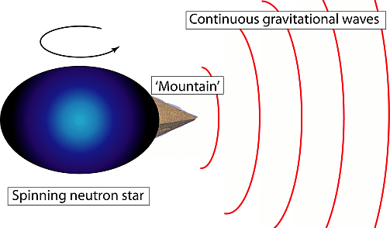
Neutron Stars
Defect leads to continuous gravitational waves
Notes:
So yeah, defects on the surface of NS result in the creation of CGW

Slide 12
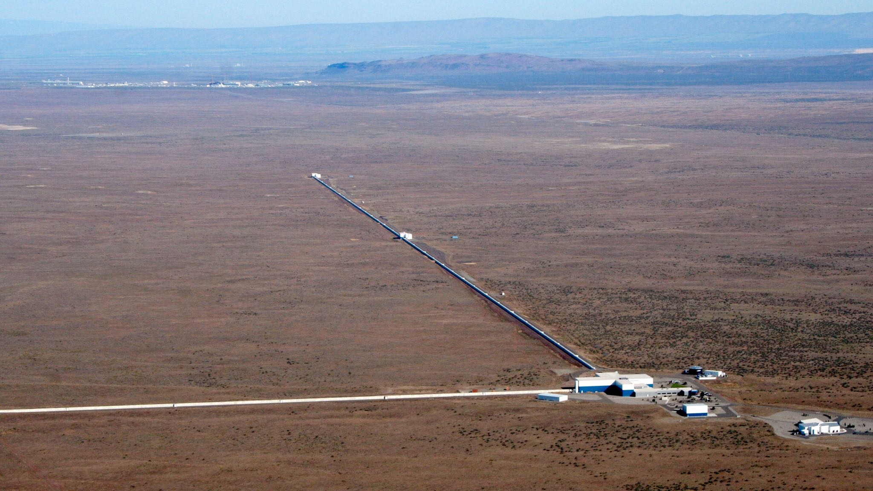
Neutron Stars
No continuous GW been detected yet
Notes:
However, we have not yet detected these
This may be because there is just too much noise in the data we receive!
Hence we must improve detection techniques! Filtering will help

Slide 13
Improving Detection of GW from Neutron Stars with Filters

Slide 14
Filters for r - mode waveforms
Continuous Waves
Stochastic Background
Compact Binary Inspiral
Burst
Notes:
So these are the four main sources

Slide 15
Filters for r - mode waveforms
r - mode signals
Frequency decreases nonlinearly with time
Change in Moment of Inertia
Notes:
Occurs when density or rotational vel changes

Slide 16
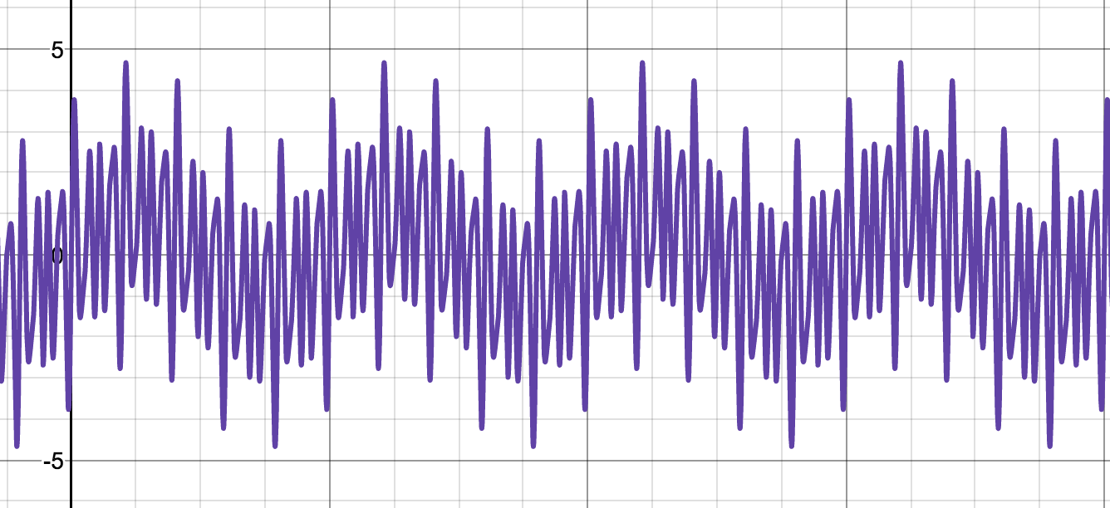
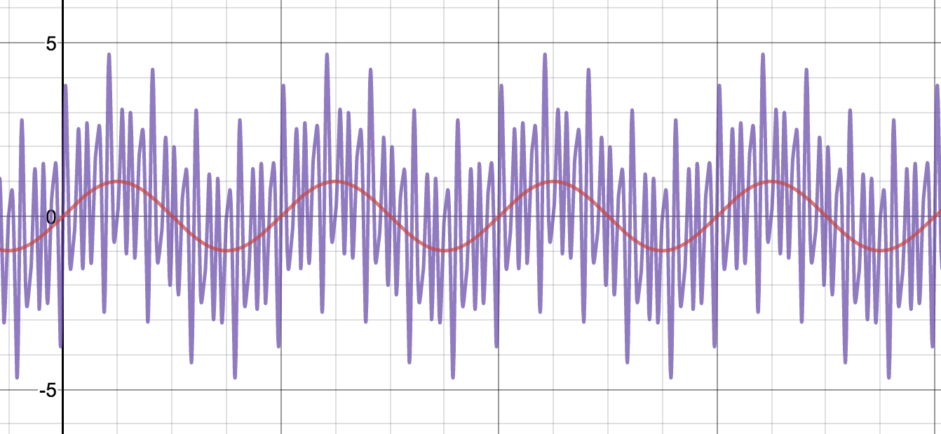
r-modes waveforms
data
continuous low frequency
Surrounding noise consists of discontinuous high frequencies

Slide 17
r-modes waveforms
noise + signal
continuous low frequency
Surrounding noise consists of discontinuous high frequencies

Slide 18
r-modes waveforms
noise + signal
LOW PASS FILTER
continuous low frequency
Surrounding noise consists of discontinuous high frequencies

Slide 19
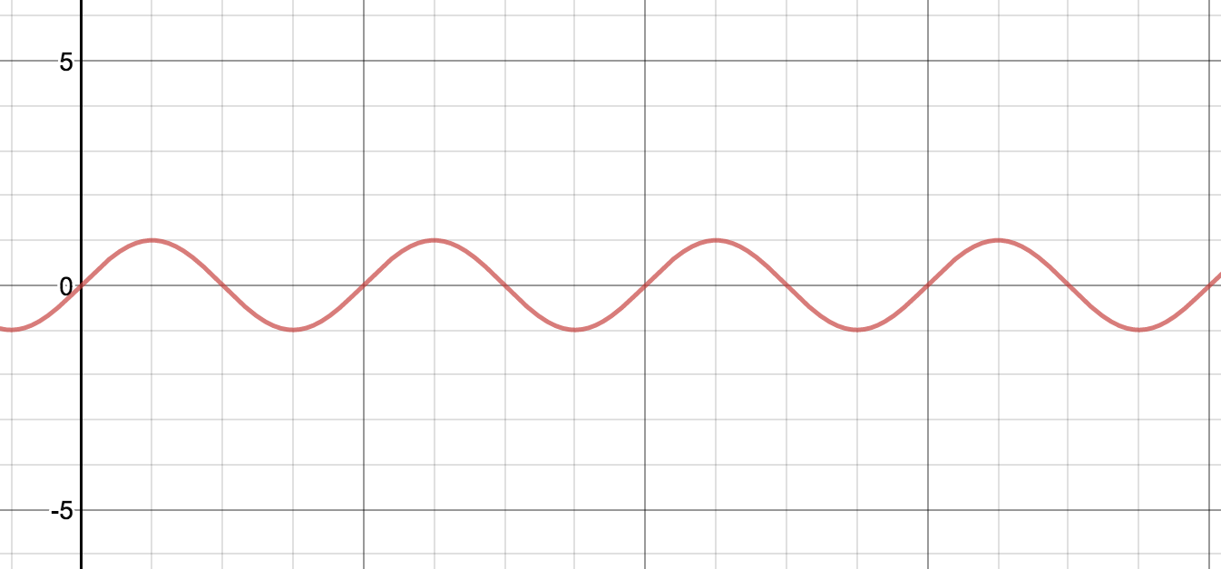
r-modes waveforms
noise + signal
LOW PASS FILTER
signal
continuous low frequency
Surrounding noise consists of discontinuous high frequencies
HIGH FREQUENCIES REMOVED

Slide 20
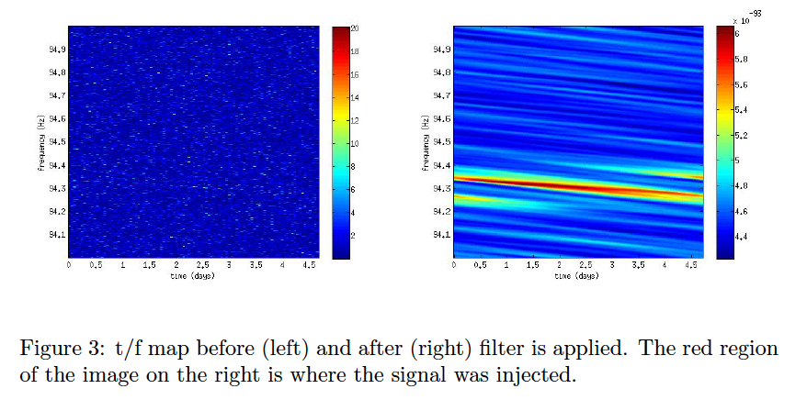
Procedure
Simulate r-mode signals and sum
2D FFT Step 1 results
FFT data containing injected r-mode signals
Inverse FFT the product of (Steps 2)³ and 3
Normalize Step 4 results
Multiply original injected r-mode data with results of Step 5
Frequency VS Time before and after filter applied

Slide 21
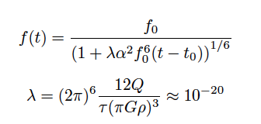
1)Simulating r-mode signals
Owen et al. 1998 model of frequency evolution of r-mode

Slide 22
1)Simulating r-mode signals
Average Density
Rotational Energy
Saturation Amplitude
Others...
Owen et al. 1998 model of frequency evolution of r-mode

Slide 23
1)Simulating r-mode signals
Chosen by studying perturbations in fluid equations

Slide 24
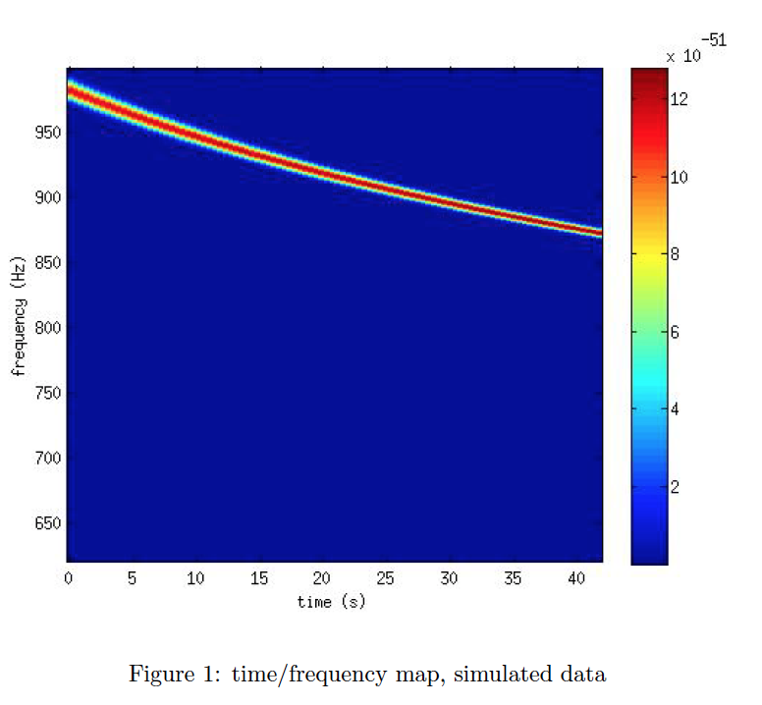
1)Simulating r-mode signals
FFT
Chosen by studying perturbations in fluid equations
Frequency VS Time (coloured by amplitude)
Created with simulated data

Slide 25
1)Simulating r-mode signals
IDEAL FILTER
FFT
Chosen by studying perturbations in fluid equations
Frequency VS Time (coloured by amplitude)
Created with simulated data

Slide 26
1)Simulating r-mode signals
Σ
IDEAL FILTERS =
more simulated signals...

Slide 27
2)2D FFT Step 1
Σ
2D FFT
IDEAL FILTERS
A( u, v)
Notes:
2D FFT get the freq an ampl

Slide 28
2)2D FFT Step 1
Σ
2D FFT
IDEAL FILTERS
A( u, v)
u, v are Fourier Space Frequencies
(Physically Meaningless)

Slide 29
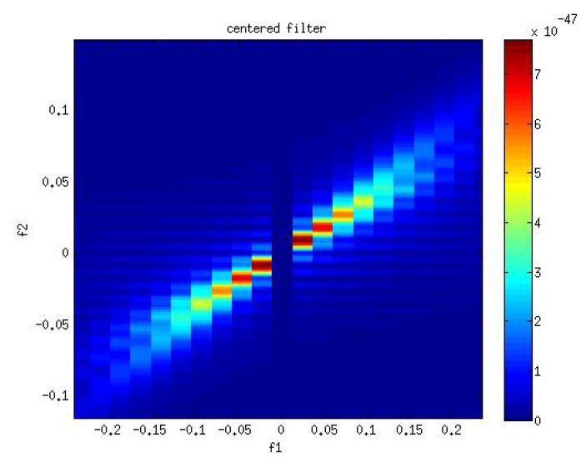
2)2D FFT Step 1
Σ
2D FFT
IDEAL FILTERS
u VS v coloured with amplitudes
Ellipse expected with more signal data
Notes:
WHERE AND WHAT ARE WE CUBING?

Slide 30
3) FFT data with Injected r-mode Signal
Frequency VS Time (coloured by amplitude)
Injected r-mode signal
Notes:
WHERE AND WHAT ARE WE CUBING?

Slide 31
3) FFT data with Injected r-mode Signal
2D FFT
A ( i, j)
Frequency VS Time (coloured by amplitude)
Injected r-mode signal
Notes:
WHERE AND WHAT ARE WE CUBING?

Slide 32
4) Inverse FFT product of Step 2 and Step 3
A ( u, v)
A ( i, j)
Notes:
WHERE AND WHAT ARE WE CUBING?

Slide 33
4) Inverse FFT product of Step 2 and Step 3
F (Model)
F (Injected)
The notation F(a) denotes the two dimensional FFT of data set ‘a’
Notes:
WHERE AND WHAT ARE WE CUBING?

Slide 34
4) Inverse FFT product of Step 2 and Step 3
F (Model)
MULTIPLICATION
F (Injected)
Notes:
WHERE AND WHAT ARE WE CUBING?

Slide 35
4) Inverse FFT product of Step 2 and Step 3
F (Model)
Y = F⁻¹ [ F(I) ☓ F(M)* ]
F (Injected)
Notes:
WHERE AND WHAT ARE WE CUBING?

Slide 36
4) Inverse FFT product of Step 2 and Step 3
*
F (Model)
Y = F⁻¹ [ F(I) ☓ F(M)* ]
F (Injected)
X’ = F⁻¹ [F(Y ☓ |Y|³ ) . F(M)]
*
equations from Sergio's 'Analisi dei Segnali' (p.230-236)
Notes:
WHERE AND WHAT ARE WE CUBING?

Slide 37
4) Inverse FFT product of Step 2 and Step 3
F (Model)
Y = F⁻¹ [ F(I) ☓ F(M)* ]
F (Injected)
X’ = F⁻¹ [F(Y ☓ |Y|³ ) . F(M)]
Inverse FFT
POTENTIAL RESULT
Notes:
WHERE AND WHAT ARE WE CUBING?

Slide 38
4) Inverse FFT product of Step 2 and Step 3
POTENTIAL RESULT
Notes:
WHERE AND WHAT ARE WE CUBING?

Slide 39
4) Inverse FFT product of Step 2 and Step 3
POTENTIAL RESULT
Frequency VS Time (coloured by amplitude)
Injected r-mode signal After Filter Applied
Notes:
WHERE AND WHAT ARE WE CUBING?

Slide 40
4) Inverse FFT product of Step 2 and Step 3
Before Filter Applied
After Filter Applied
Notes:
WHERE AND WHAT ARE WE CUBING?

Slide 41
4) Inverse FFT product of Step 2 and Step 3
Before Filter Applied
After Filter Applied
Notes:
WHERE AND WHAT ARE WE CUBING?

Slide 42
4) Inverse FFT product of Step 2 and Step 3
Lot of unnecessary data
After Filter Applied
Notes:
WHERE AND WHAT ARE WE CUBING?
So we normalize the amplitudes of the t/f map
such that the maximum amplitude in the peakmap is the same as the maximum
amplitude in the t/f map. Additionally, we smooth the normalized amplitudes
from the enhanced t/f map with a sigmoid function to make the signal more
continuous. Now, we multiply the enhanced,

Slide 43
5) Normalising Amplitudes
Normalise Amplitudes

Slide 44

5) Normalising Amplitudes
Normalise Amplitudes
Notes:
sigmoid function to make the signal more
continuous

Slide 45
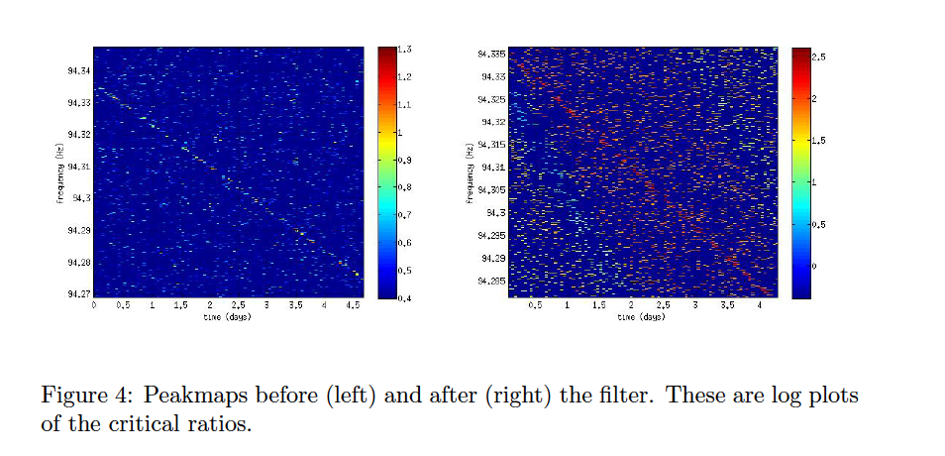
6) Product of Step 3 and Step 5 and getting Peaks
Before Filter
After Filter
Peakmap of the frequency VS time plots
Notes:
sigmoid function to make the signal more
continuous

Slide 46
Quantifying Effectiveness
Max[ Max( S ) ]
R =
Mean[ Mean( P ) ]
Is the filter helping?
R_{Filtered}
E =
R_{Unfiltered}
Notes:
Unfortunately, the power due to the injected signal is spread across many fre-
quency bins, so it is not clear yet how we can estimate an improvement in SNR.
However, we can determine how 'enhanced' the image is, meaning how do the
critical ratios around the injection compare to critical ratios due to noise before
and after the lter?
For the peakmaps before and after the lter, we extract
a submatrix that contains the critical ratios corresponding to the duration of
the signal and the maximum change in frequency.
We then nd the maximum
value of the critical ratio in each matrix. Then, we zero the corresponding en-
tries in the original peakmap matrix that correspond to the injection, and then
calculate the mean of the matrix that only contains critical ratios due to noise.
Let S be either the old or new submatrix, and P the old

Slide 47
Quantifying Effectiveness
Max[ Max( S ) ]
R =
Mean[ Mean( P ) ]
Is the filter helping?
R_{Filtered}
E =
R_{Unfiltered}
E = 3.07
For the single r-mode filter we have used
Notes:
Unfortunately, the power due to the injected signal is spread across many fre-
quency bins, so it is not clear yet how we can estimate an improvement in SNR.
However, we can determine how 'enhanced' the image is, meaning how do the
critical ratios around the injection compare to critical ratios due to noise before
and after the lter?
For the peakmaps before and after the lter, we extract
a submatrix that contains the critical ratios corresponding to the duration of
the signal and the maximum change in frequency.
We then nd the maximum
value of the critical ratio in each matrix. Then, we zero the corresponding en-
tries in the original peakmap matrix that correspond to the injection, and then
calculate the mean of the matrix that only contains critical ratios due to noise.
Let S be either the old or new submatrix, and P the old

Slide 48
Summary of Steps
Simulate r-mode signals and sum
2D FFT Step 1 results
FFT data containing injected r-mode signals
Inverse FFT the product of (Steps 2)³ and 3
Normalize Step 4 results
Multiply original injected r-mode data with results of Step 5
Frequency VS Time before and after filter applied

Slide 49
What I want to see in Rome

Slide 50
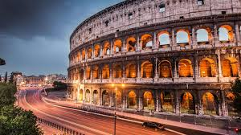
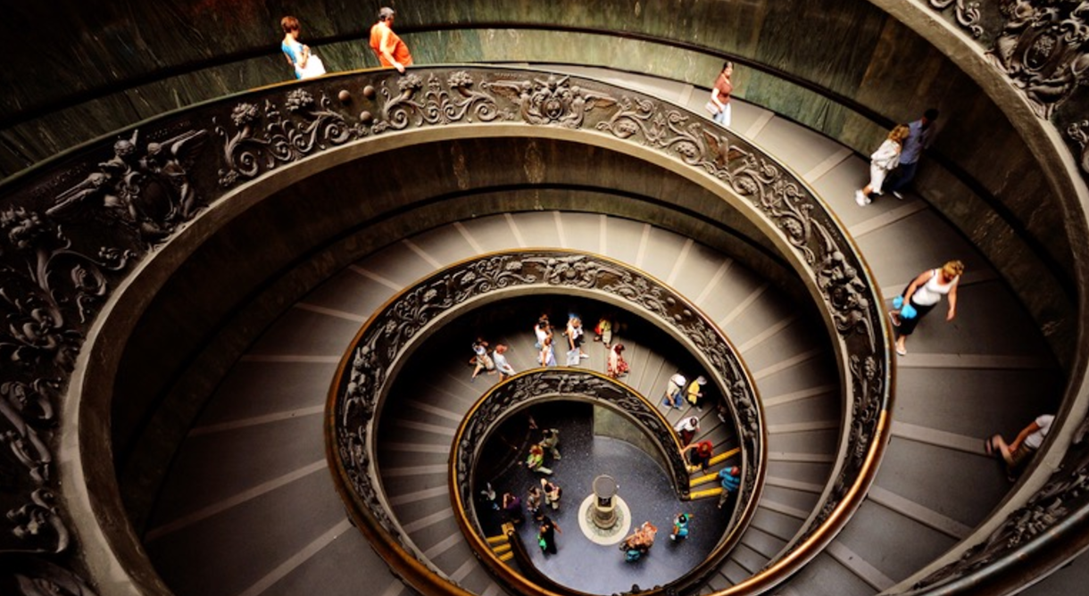
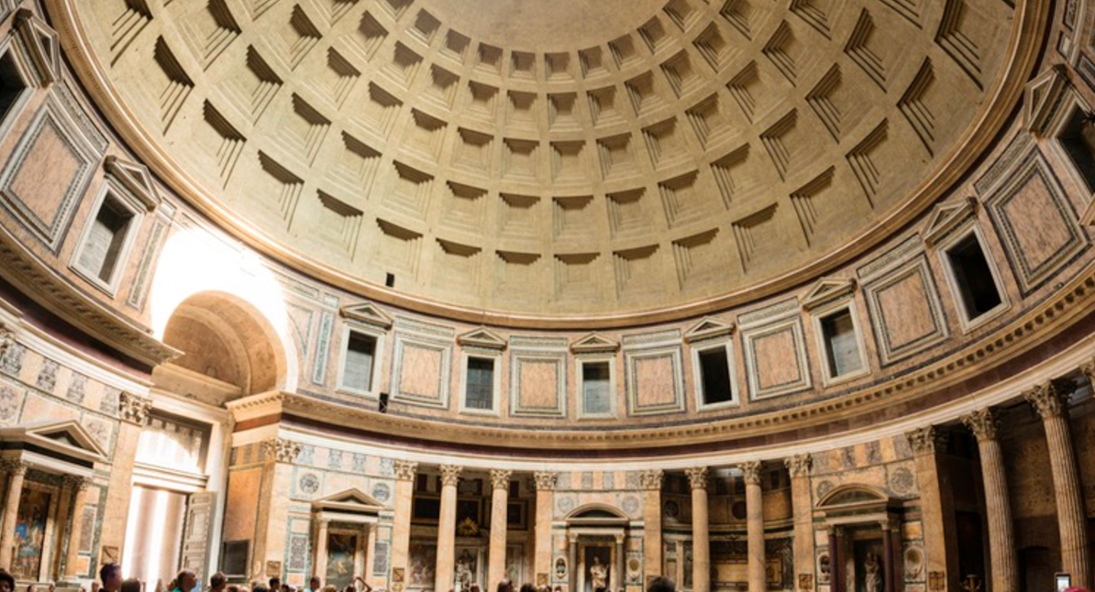
Typical Touristy Stuff
Colosseum
Pantheon
Vatican Museums

Slide 51
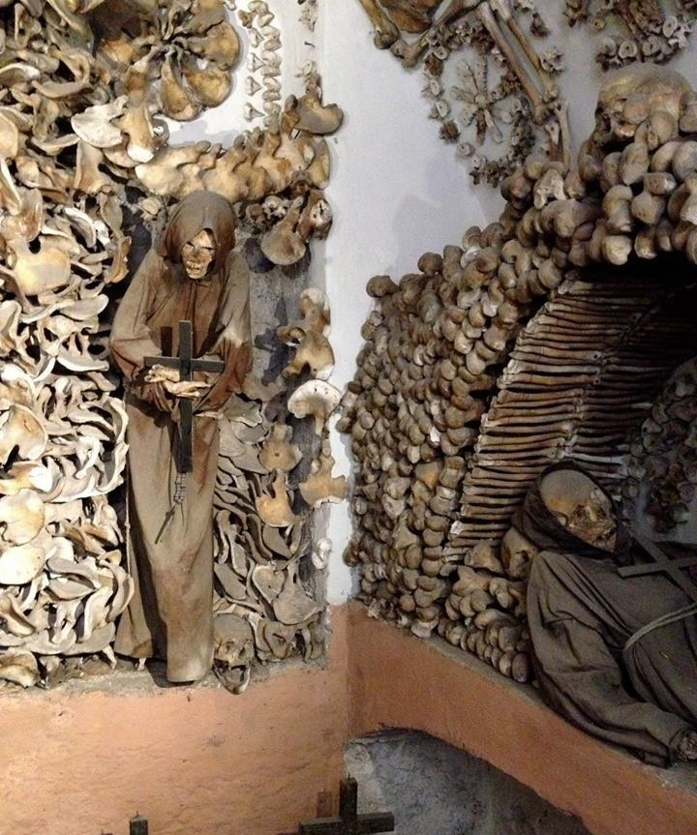
Concezione Crypts
The crypts of Capuchin friars decorated with the bones of over 4,000 friars, including an entire "crypt of pelvises."

Slide 52
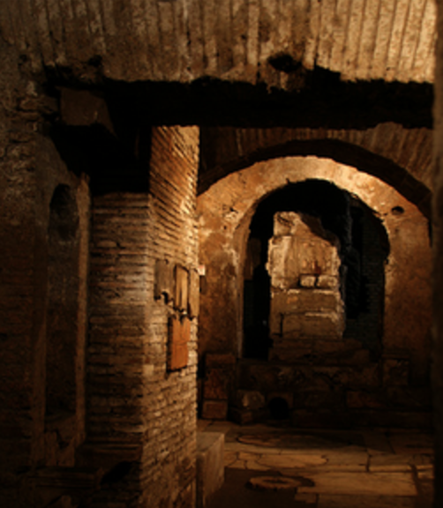
The Mithraeum
The underground sanctuary of a mysterious ancient cult

Slide 53
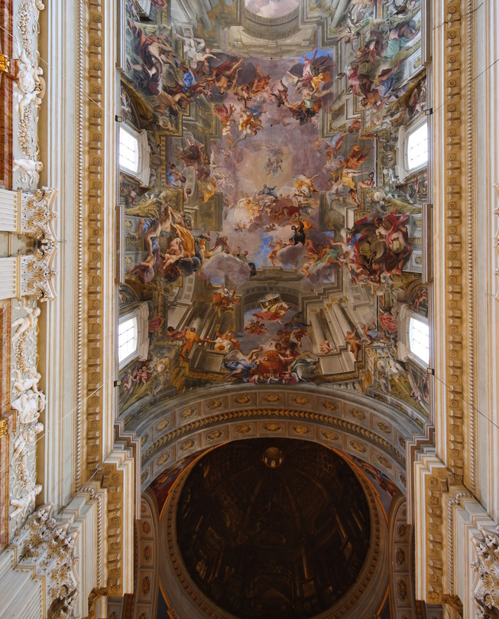
The Dome Illusion
A master of trompe-l'oeil creates a stunning tourist-fooling dome out of a flat ceiling.

Slide 54

Atlas Obscura
Website with interesting info about tourist sites

Slide 55
Thank you!

Slide 56
Extra Slides

Slide 57
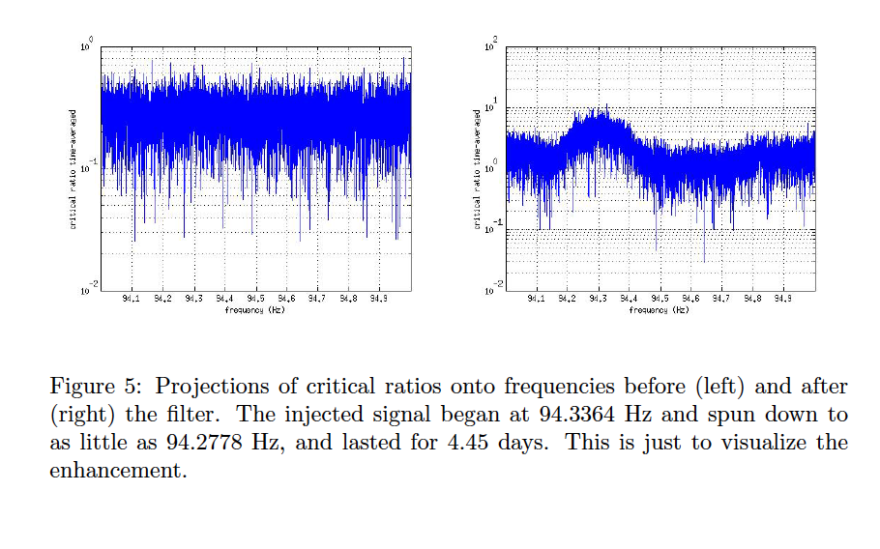
Projection on Frequency Axis
2D FFT of the signals t/f map and noise t/f map separately
divide the power spectrum of the signals by the power spectrum of the noise.
multiply this ratio by the t/f map containing all the peaks
multiply this enhanced t/f map with the original peakmap.
Critical Ratios VS Frequency before and after filter applied

